Slide 1
Comparative Study
of Countries
Problem Statement Scenario:
You are a data analyst working for an insurance company. The company is expanding and wants to open new branches in various parts of the world. Your task is to compare various parameters such as income, life insurance share, market share, penetration, ratio of reinsurance accepted, and retention ratio of different countries using the sample insurance dataset and world development indicators dataset.
Objective:
Create a dashboard to compare all the parameters mentioned above for different countries, to strategize market penetration and to target new customers.
Datasets:
Primary Dataset – Insurance Sample Dataset
Secondary Dataset – Global Financial Development Database

Slide 2
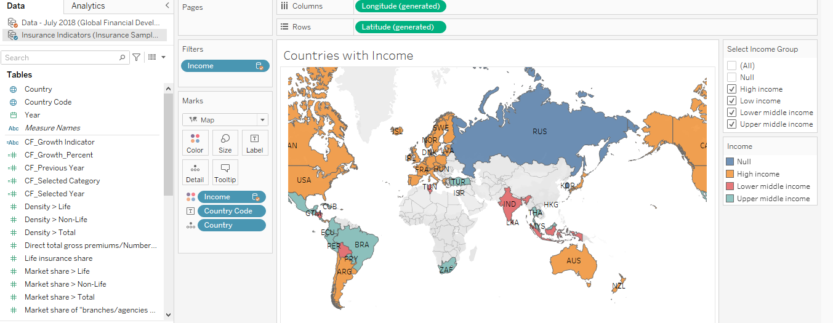
Create Geographic Map
Task 1. Create a geographic map showing the countries' fields. Color the map based on the income column from the secondary dataset.
Include income group filter in the dashboard

Slide 3
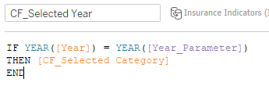
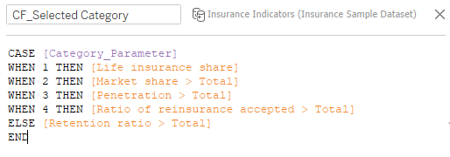

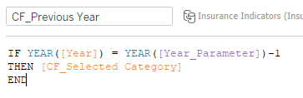
Create a KPI Table
Task 2. Create two parameters for Year Selection and Category Selection
Category parameter includes life insurance share, market share, penetration, ratio of reinsurance accepted, and retention ratio

Slide 4

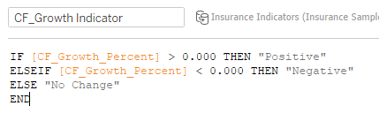
Create a KPI Table
Task 2. Create a calculated field to calculate the Growth %

Slide 5
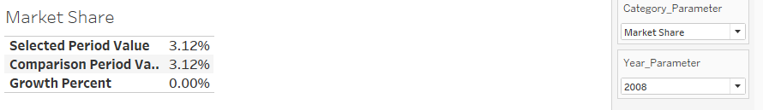
Create a KPI Table
Task 2. Create a table to show these values

Slide 6
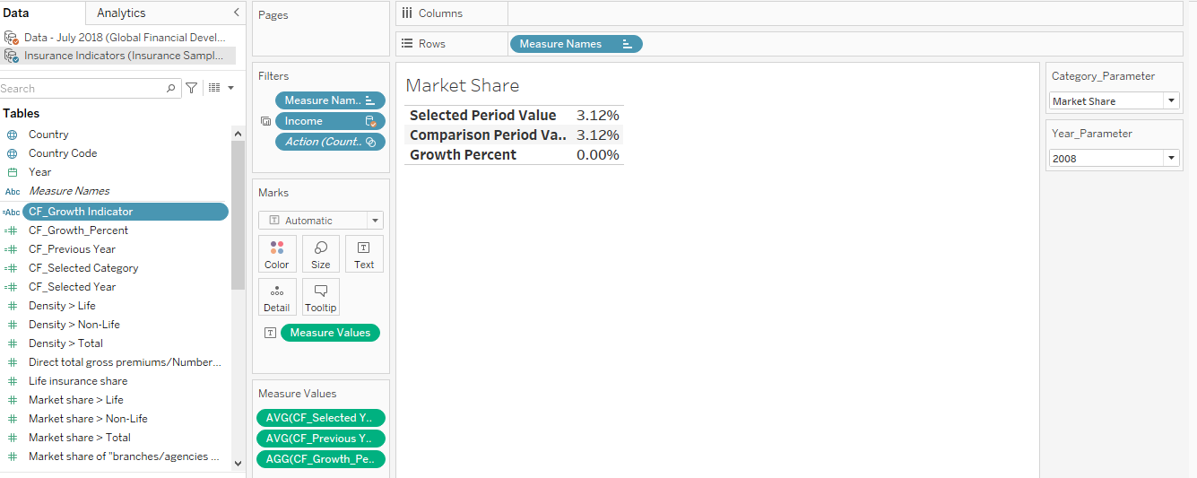
Create a KPI Table
Task 2. Title should be updated based on the category selection

Slide 7
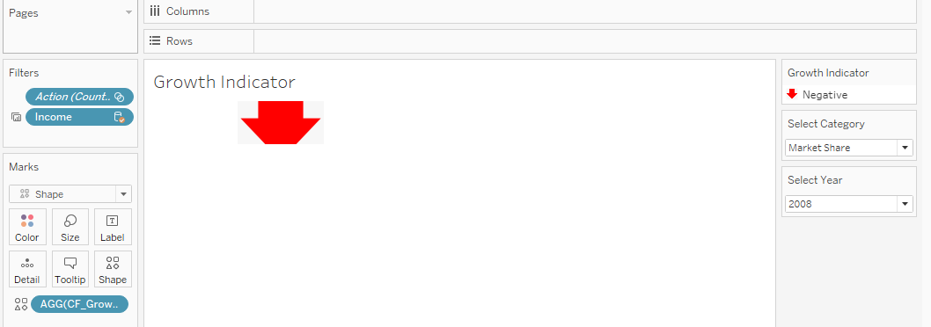
Growth Indicator Shapes
Task 3. Create Growth Indicator Shapes based on the Growth %
Growth indicator displays Negative, No Change, and Positive as values and corresponding shapes against it
encoder

Slide 8
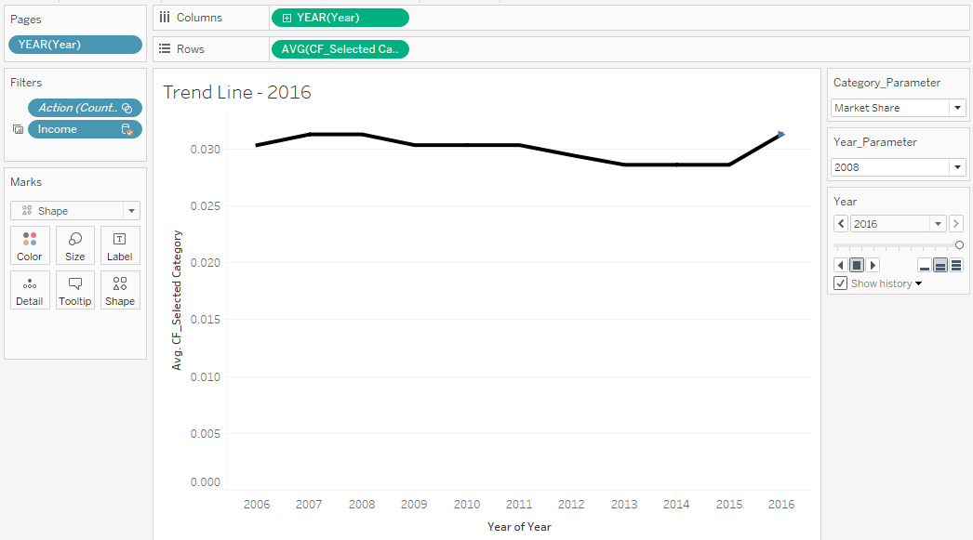
Trend Line
Task 4: Create a trend line to show the selected category values
The line shows an arrow or triangle at the last mark

Slide 9
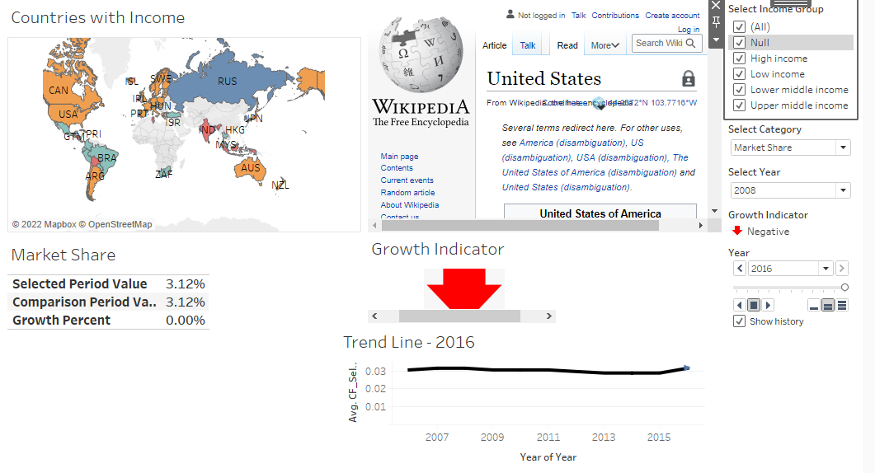
Create Dashboard
Task 5: Create a dashboard filter for income group to be applied for all charts with the filter action enabled in the map as well

